Slide 1
BIT 324 Mobile Communication
Middleware and Gateways

Slide 2
Lecture Overview
Bearers
MIDDLEWARE AND GATEWAYS

Slide 3
Bearers
For different type of networks, there are different types of transport bearers.
These can be TCP/IP, http, protocols or dialup connection.
For GSM it could be SMS, USSD (Unstructured Supplementary Service Data) or WAP.
For mobile or fixed phone, it will be Voice.

Slide 4
MIDDLEWARE AND GATEWAYS
Any software layered between a user application and operating system can be termed as middleware.
Middleware examples are
  communication middleware,
  object oriented middleware,
  message oriented middleware,
  transaction processing middleware,
  database middleware,
  behavior management middleware,
  RPC middleware
  etc.

Slide 5
MIDDLEWARE AND GATEWAYS
There are some middleware components like behavior management middleware, which can be a layer between the client device and the application.
In mobile computing context we need different types of middleware components and gateways at different layers of the architecture (Figure 1).
These are:
1. Communication middleware
2. Transaction processing middleware
3. Behavior management middleware
4. Communication gateways.

Slide 6
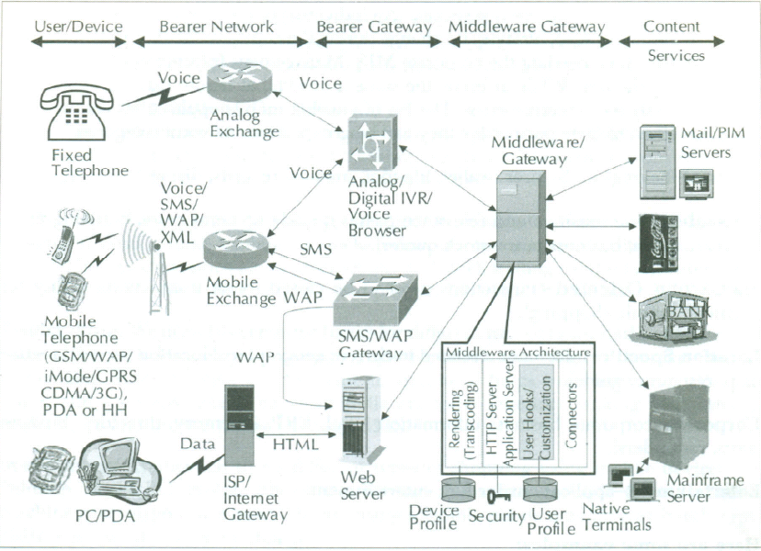
Figure 1: A schematic Representation of a Mobile Computing Environment

Slide 7
Communication Middleware
The application will communicate with different nodes and services through different communication middleware.
Different connectors for different services will fall in this category.
Examples could be TN3270 for IBM mainframe services, or Javamail connector for IMAP or POP3 services

Slide 8
Transaction Processing Middleware
In many cases a service will offer session oriented dialogue (SoD).
For a session we need to maintain a state over the stateless Internet.
This is done through an application server.
The user may be using a device, which demands a short transaction whereas the service at the backend offers a SoD.
In such cases a separate middleware component will be required to convert a SoD to a short transaction.
Management of the Web components will be handled by this middleware as well.

Slide 9
Behavior Management Middleware
For different devices we need different types of rendering.
We can have applications, which are developed specially for different types of rendering.
For example, we can have one application for Web, another for WAP, and a different one for SMS.

Slide 10
Behavior Management Middleware
On the contrary, we may choose to have a middleware, which will manage entire device specific rendering at the run time.
This middleware will identify the device properly and handle all the behavior related stuff independent of the application.
The system may be required to have some context awareness.
All these will be handled by behavior management middleware.

Slide 11
Communication Gateways
Between the device and the middleware there will be network of networks.
Gateways are deployed when there are different transport bearers or networks with dissimilar protocols.
For example, we need an IVR (Interactive Voice Response) gateway to interface voice with a computer, or an WAP gateway to access internet over a mobile phone.
The following diagram (Figure 1) depicts a schematic diagram of services in a mobile computing environment where services from enterprise to a vending machine can be used from different devices.

